Slide 1
How to Comment
Coding Standardisation Tutorial
Tips, guides, resources for imporving code quality
and life quality
Mark Sen Dong
09 June 2020

Slide 2
01
Knowing what to comment
02
When not to comment
CONTENTS
03
Record your thoughts
04
Put yourself in the reader's shoes
05
Conclusion / Guidelines

Slide 3
01
Knowing what to comment
Explaining “What the code is doing” is only a very small part of commenting.

Slide 4
Knowing what to comment
Key idea: The purpose of commenting is to help the readers to know as much as the author.
Need to know when not to comment?
Record your thoughts and ideas
Put yourself in the reader's shoes

Slide 5
02
When not to comment?
Reading comments will consume attention and time from reading actual code.
Therefore, they better be worth it.

Slide 6
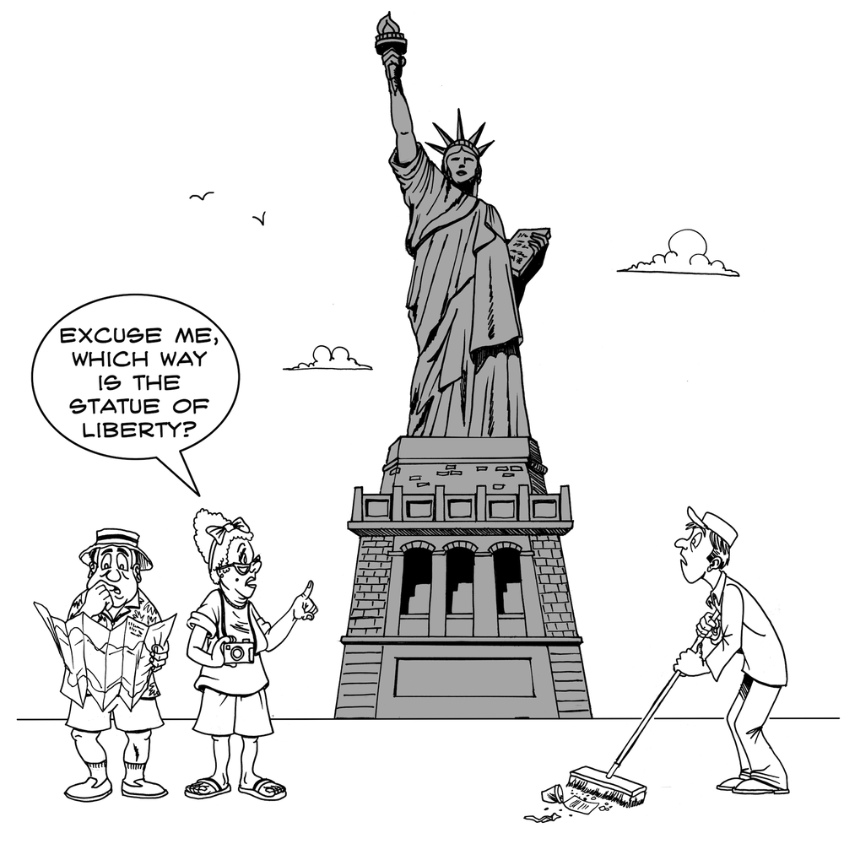
When not to comment?
Example:
% The class definition for Account
class Account {
% Constructor
Account();
% Set the profit member to a new value
SetProfit(profit);
% Return the profit from this Account
GetProfit();
};
Don't comment on facts which can be quickly derived from code. Don't comment the obvious.

Slide 7
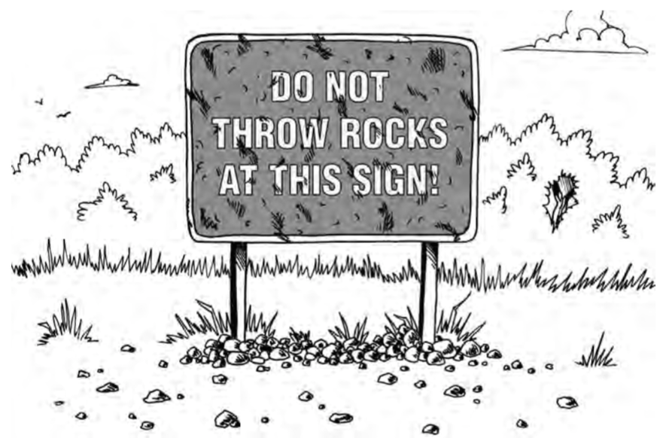
When not to comment?
Example:
% Find the Node in the given subtree, with the given name, using the given depth.
Node * FindNodeInSubtree(Node * subtree, name, depth);
Improved Example:
% Find a Node with the given 'name' or return NULL.
% If depth <= 0, only 'subtree' is inspected.
% If depth == N, only 'subtree' and N levels below are inspected.
Node * FindNodeInSubtree(Node * subtree, name, depth);
Don't comment for the sake of commenting.
Comments are not meant to describe the code.

Slide 8
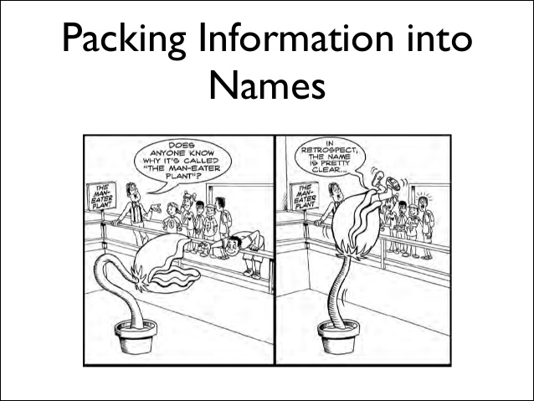
Don't use comment to justify badly named variables
Example:
% Releases the handle for this key. This doesn't modify the actual registry.
DeleteRegistry(RegistryKey);
Improved Example:
ReleaseRegistryHandle(RegistryKey);
A good variable name is more imporant than a good comment.
Because you will see the name everywhere.
Good Code > Bade Code + Good Comment

Slide 9
03
Record your thoughts
Good comments can emerge from simply 'record your thoughts' while you are coding.
Those important ideas you had when you were coding are valuable.

Slide 10
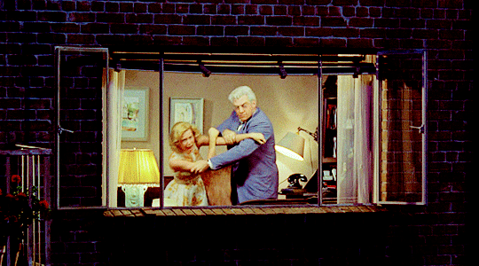
Director's commentary
Example:
% Surprisingly, using binary tree on the data set is 40% faster than using hash table.
% The computational cost of hash calculation is much more than using binary search
% It is ok that the function returns Null on the few subjects, it is not worth it to solve the problem 100%
“We get glimpses into other apartments, but we never actually enter them. This is the perfect setup for a film in which Hitchcock can show us as much as he can, but only show enough so that he can still create a sense of suspense.” --Commentary on Alfred Hitchcock's Rear Window (1954)
Director's commentary in films usually gives the director's opinion about the scenes. It helps the viewers to understand the reasoning behind the artistic decisons of the director.

Slide 11

Write comments for the imperfections
Example:
% The class is getting chaotic,
% maybe we should create another subclass to help organising it.
% TODO: should use a faster algorithm
Common tags in comments
Tag | Meaning
TODO: | Isssues which have not be addressed
FIXME: | Part of the code which for sure doesn't work
HACK: | A quick and dirty solution for a problem
XXX: | Danger! Major problem discovered!
Code is always evolving and improving. Don't be embarassed to noted down the temporary problems the code has.
Admit the imperfections of today, and encourage your future self or other future coders to improve or fix it.

Slide 12
Provide additional explanation for constants
When define a constant value, there is usually a back story about what it is? What's its purpose? Why it has this value?
As the author, you should take the responsibility to tell the others why you defined a constant as it is.
It is not hard, you just need to remember leaving a comment while coding it.
Example:
% Impose a reasonable limit: No humans can read that much anyway.
MAX_RSS_SUBSCRIPTION = 1000;
% Users thought 0.72 gave the best size/quality tradeoff of the images.
imageQuality = 0.72;

Slide 13
04
Put yourself in the reader's shoes
Imagine how your code looks like to an outsider.
By the way, the outsider is not familiar with your project.

Slide 14
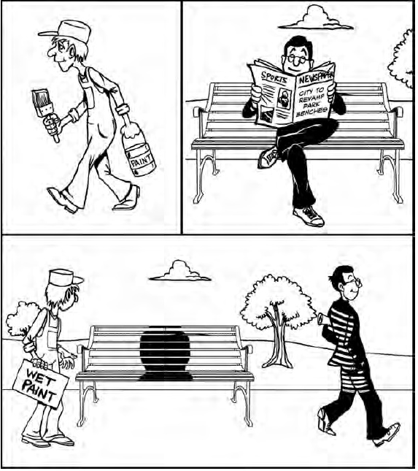
Declare potential problems
Example:
% Call external server to send email. (Timeout after 1 min)
SendEmail(to, subject, body);
% The execution time is 2^subjectCount, be aware when subjectCount is large!
ExhaustiveSearch(subjects, subjectCount);
Are there any part of the code which is ambiguous?
Could the function be misused?
Declare potential problems which you can already anticipate.

Slide 15
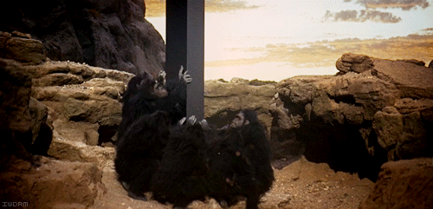
High level commentary
Example:
% This script includes some auxilliary functions.
% They provides convenient interface for our system settings.
% They handle file permissions and other system details.
“The scene where the primitive anthropoids touched the black monolith indicates the dawn of Man. The alien object gave spark of wisdom to our ancestors, thus begun the process of aquiring higher intelligence.”
--Commentary on Stanley Kubrick's 2001: A space Odyssey (1968)
High level commentary should explain to new developers, how do this function interact with others, how does data flow through the pipeline, what is the importance of this function in the whole system, etc.

Slide 16
05
Conclusion / Guidelines
“Commenting is like sex.
When it's good, it's very, very good,
and when it's bad, it's better than nothing.”

Slide 17
Conclusion / Guidelines
When not to comment:
When the fact can be easily derived from the code
When badly named variables/functions are causing complications: improve the names.
What thoughts should you record:
Explain why the code is written this way, what are the advantages, just like director's commentary
Pointing out the imperfections
Back stories behind the constants, why are they defined with the current values.
Put yourself in the reader's shoes:
Give answers to anticipated questions you can think of
Give warnings to situations where you know that it might potentially go wrong
Provide high level comment to summarise the importance of this part of the code in the overall system, and how they interact
How to overcome the difficulties of writting comments:
No matter what you are thinking while coding, write it down first
Read over it, see if you can write it better
Improve your comments
Common Tags | Meaning
TODO: | Isssues which have not be addressed
FIXME: | Part of the code which for sure doesn't work
HACK: | A quick and dirty solution for a problem
XXX: | Danger! Major problem discovered!

Slide 18
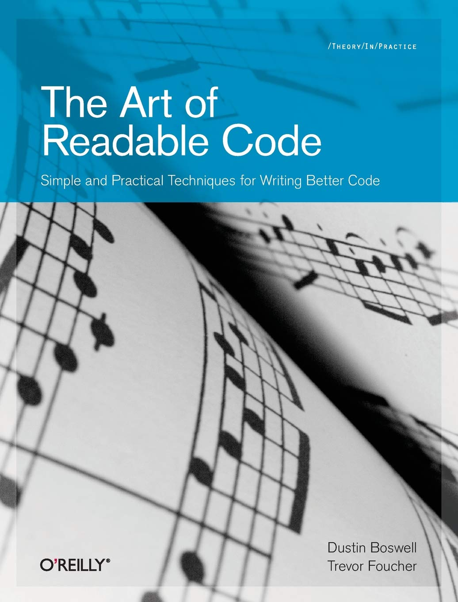

Thank you!
Most contents are extracted from Chapter 5 of the book:
The Art of Readable Code: Simple and Practical Techniques for Writing Better Code
Dustin Boswell, Trevore Foucher, 2011
VISIT MY GITHUB FOR ADDITIONAL RESOURCES
https://github.com/MarkSenDong/Code_Standardization

